Slide 1
PAWPAL
A pet care mobile application
Supervisor:
Ms. Amna Irum
Group Members:
Huzaifa Nasir 22I-1053
Maaz Ali 22I-1042
Hamza Naveed 22I-0961
1
Notes:
PawPal is a comprehensive pet care mobile application designed to revolutionize the way we care for our furry companions, integrating health, community, and commerce all in one place.

Slide 2
Table of contents
01
02
03
04
05
Overview
Itetration 3
Module 1
06
Module 2
Module 3
Module 4
2

Slide 3
01
Overview
3

Slide 4
Overview
All-in-one
Community
Global platform
AI-powered breed-specific health and care plans
Active user forums for advice and support
All-in-one pet care platform
Single app for health tracking, vet bookings, marketplace
4
Notes:
First, under the 'All-in-one' objective, we aim to create a seamless, unified experience. This means users will have a single dashboard that integrates their pet's profile, social connections, and marketplace activities. We want to eliminate the need for multiple apps by providing a single solution for essential tasks like health tracking, booking veterinarian appointments, and even trading or selling toys.
Second, our 'Community' objective is about building a global network for pet lovers. This includes a platform for peer-to-peer trading of pet supplies. A key differentiator is our commitment to providing AI-powered, breed-specific health and care plans, ensuring every pet gets personalized attention. Finally, we will facilitate active user forums where owners can seek advice, share experiences, and find support from fellow pet enthusiasts.

Slide 5
Faculty Feedback
Presentation | Good Work
Comments | UI needs improvements
5

Slide 6
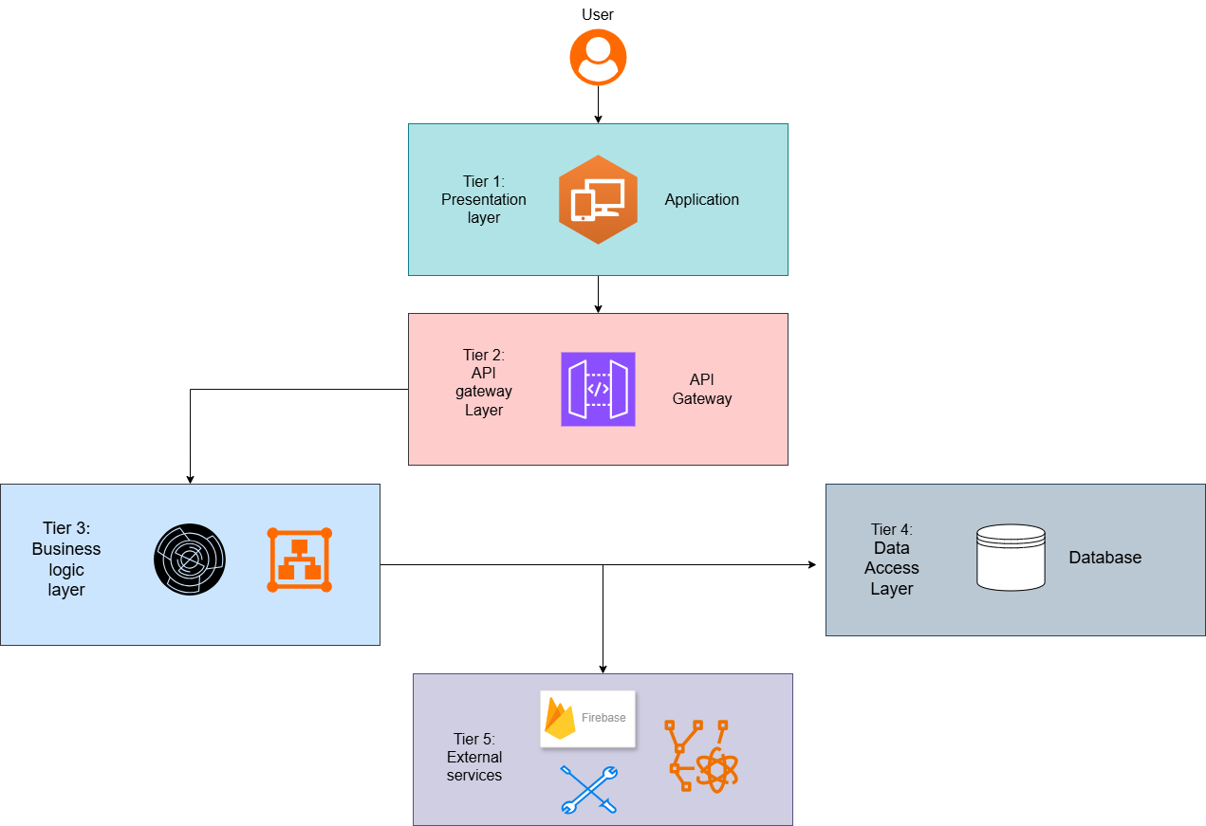
8
Notes:
Starting from the top, Tier 1 is our Presentation Layer. This is the mobile application itself, the user interface that you interact with on your device.
All requests from the app are funneled through Tier 2, the API Gateway Layer. This acts as a single entry point, managing request routing, authentication, and security, protecting our core systems.
The requests then move to Tier 3, the Business Logic Layer. This is the brain of our application, where all the core processing happens. It contains all our key modules, such as User Management, the Pet Identification Module, and others we'll discuss shortly.
When the business logic needs to store or retrieve data, it communicates with Tier 4, the Data Access Layer. This layer handles all interactions with our database, ensuring data is persisted correctly and efficiently.
Finally, Tier 5 connects us to External Services. This includes third-party platforms we leverage, such as Firebase for notifications and other cloud-based services to enhance functionality.

Slide 7
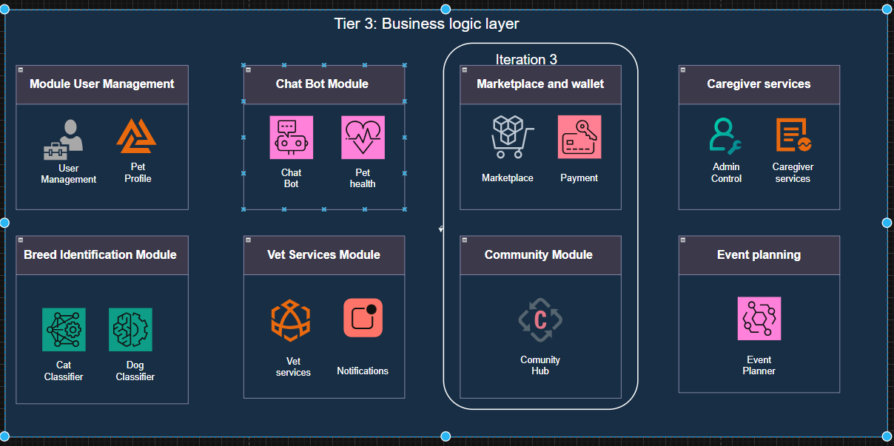
10

Slide 8
02
Iteration 03
11

Slide 9
Goals
1. Marketplace
- Developing a multi-vendor e-commerce platform.
-Implementing a robust rating and review
2. Community Hub
- Developing a real-time social forum for pet owners
- Facilitating pet adoptions
- Event management with RSVP tracking..
3. Caregiver Services
- Connecting owners with verified pet walkers
and sitters through a booking system.
12

Slide 10
Goals
4. Admin Portal
- Building a centralized dashboard for role-based
access control.
- Developing real-time system monitoring,
- Analytics reporting.
5. Backend API Base Structure
- RESTful API architecture
- Core API endpoints implementation
13

Slide 11
03
Marketplace
14

Slide 12
Requirements
1. System must support seller listings with inventory tracking, rich media descriptions, and category filtering.
3. A personalized user hub for tracking order history, managing multiple shipping addresses
2. A multi-dimensional feedback system for buyers and sellers to ensure marketplace integrity, supported.
Process uploaded images through a model and return breed identification.
4. Detailed reporting tools for sellers to monitor sales trends, revenue growth, and customer feedback.
16

Slide 13
04
Community Hub
22

Slide 14
Requirements
1. Implement community where you can interact with other people, share pet-related experiences, and engage in social discussions.
3. A dedicated module for the community in which you can easily adopt a new pet or list a pet for adoption.
2. A system where you can either report a lost or found pet, or view an active list of pets reported as lost or found in your local area.
Process uploaded images through a model and return breed identification.
4. A feature in which users can list which pet events are taking place, and you can RSVP directly to confirm your attendance.
16

Slide 15
04
Caregiver Services
22

Slide 16
Requirements
1. A system that allows users to register as caregivers by providing their service offerings and experience.
3. A feature that enables pet owners to browse caregiver profiles, select time slots, and book them for services.
2. A specialized dashboard for caregivers to manage their availability, view booking requests, and their active service schedules.
Process uploaded images through a model and return breed identification.
4. An integrated messaging system where pet owners can chat directly with caregivers.
16

Slide 17
05
Admin Portal
22

Slide 18
Requirements
1. A comprehensive web-based dashboard providing real-time analytics on app usage, transactions across the entire ecosystem.
3. A centralized interface to review all registered users and their added pets, and ensure data compliance.
2. Full access to review and verify professional accounts, to maintain high service standards and safety.
Process uploaded images through a model and return breed identification.
4. Total administrative access to manage marketplace, monitor product listings, to ensure a secure commercial environment.
16

Slide 19
Remaining Work
Payment Gateway Integration: Finalizing secure checkout flows for cryptocurrency and digital wallet transactions.
UI/UX Refinement & Polishing: Enhancing the mobile interface for a more seamless and intuitive user experience across all modules.
Real-time Caregiver GPS Tracking: Implementing live location services and route history for pet walking and sitting activities.
Emergency Alert Broadcasting: Deploying the radius-based notification system for instant lost pet community alerts.

Slide 20
05
Architecture
25

Slide 21
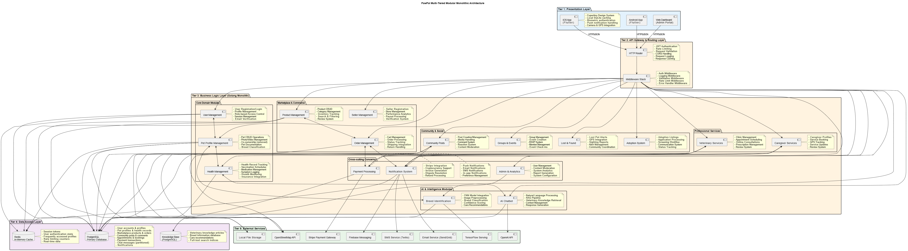
Architecture Diagram
26

Slide 22
Contribution
Huzaifa Nasir
Maaz Ali
Hamza Naveed
Community Module & Social Architecture.
Administrative Dashboard
Caregiver Service Ecosystem
Marketplace Engineering:
E-Commerce Core & Logic
Backend & System Integration
36

Slide 23
05
Live Demo
37

Slide 24
Thanks
Do you have any questions?
Please keep this slide for attribution

